Slide 1

Program in

Slide 2
Previous Classes
Basic of C
Array & Dimensional array
Variables & Data Types
Strings & Methods
Input / Output Statements
Functions & Arguments
Types of Operator
Pointers
Decision making Statements
Structures
Switch Statements
Looping Statements

Slide 3
File Management

Slide 4

FILES
A file a container in a computer system that stores data, information, settings, or commands, which are used with a computer program.

Slide 5
















Some File Formats

Slide 6
Today’s Content
Open / close files
Special
Write data to files
Start-up Mini Project
Reading data to files
Error handling files
Command line arguments

Slide 7


Types of Files
TEXT File
Binary
File
A text file contains data in the form of ASCII characters and is generally used to store a stream of characters.
Each line in a text file ends with a new line character (‘\n’).
It can be read or written by any text editor.
They are generally stored with .txt file extension.
Text files can also be used to store the source code.
A binary file contains data in binary form (i.e. 0’s and 1’s) instead of ASCII characters. They contain data that is stored in a similar manner to how it is stored in the main memory.
The binary files can be created only from within a program and their contents can only be read by a program.
More secure as they are not easily readable.
They are generally stored with .bin file extension.

Slide 8
Open / close Files
Declare Pointer Variable (syntax)
FILE *file_pointer_name;
Open File (syntax)
file_pointer_name = fopen(const char *file_name, const char *mode);
Close File (syntax)
fclose(FILE *file_pointer_name);
Example
#include <stdio.h>
int main(){
char name[10];
FILE *fp;
fp = fopen("file.txt", "r");
fclose(fp);
}

Slide 9
Open / close Files
Files Mode
Mode | Sort Description
r | Read text file
w | Write text file
a | Append text file
rb | Read binary file
wb | Write binary file
ab | Append binary file
Example
#include <stdio.h>
int main(){
char name[10];
FILE *fp;
fp = fopen("file.txt", "r");
fclose(fp);
}
r+ | r + b / rb+
a+ | a + b / ab+
w+ | w + b / wb+

Slide 10
Write Data for Files
fprintf() – syntax
int fprintf(FILE *stream, const char *format, ...);
fputc() - syntax
int fputc(int c, FILE *stream);
fwrite() – syntax
int fwrite(const void *str, size_t size, size_t count, FILE *stream);
fputs() - syntax
int fputs(const char *str, FILE *stream);

Slide 11
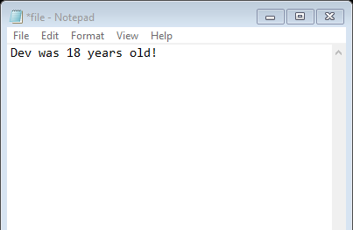
Write Data for Files
fprintf() - Example
#include <stdio.h>
int main(){
char name[30];
int age;
FILE *fp;
printf("Enter Name: ");
gets(name);
printf("Enter age: ");
scanf("%d", &age);
fp = fopen("file.txt", "w");
fprintf(fp, "%s was %d years old.", name, age);
fclose(fp);
printf("Data stored in file!");
}
Syntax
int fprintf(FILE *stream, const char *format, ...);
output
Enter Name: Dev
Enter age: 18
Data stored in file!

Slide 12
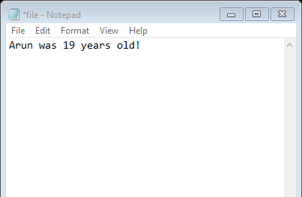
Write Data for Files
fputs() - Example
#include <stdio.h>
int main(){
char name[30];
char age[12];
FILE *fp;
printf("Enter Name: ");
gets(name);
printf("Enter age: ");
gets(age);
fp = fopen("file.txt", "w");
fputs(name, fp);
fputs(" was ", fp);
fputs(age, fp);
fputs(" years old! ", fp);
fclose(fp);
printf("Data stored in file!");
}
syntax
int fputs(const char *str, FILE *stream);
output
Enter Name: Arun
Enter age: 19
Data stored in file!

Slide 13
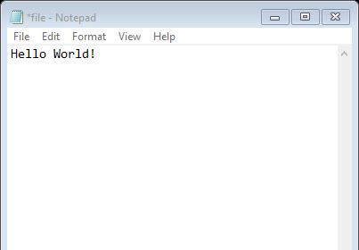
Write Data for Files
fputc() - Example
#include <stdio.h>
#include <string.h>
int main(){
char text[30];
FILE *fp;
printf("Enter some character: ");
gets(text);
fp = fopen("file.txt", "w");
for (int i = 0; i<strlen(text); i++){
fputc(text[i], fp);
}
fclose(fp);
printf("Data stored in file!");
}
syntax
int fputc(int c, FILE *stream);
output
Enter some character: Hello World!
Data stored in file!

Slide 14
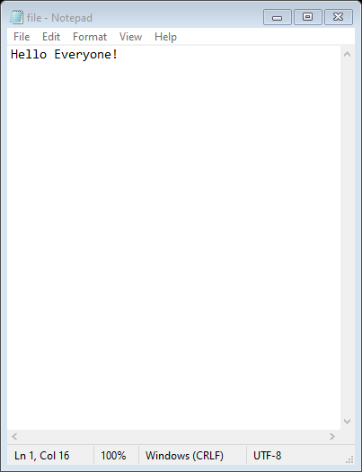
Write Data for Files
fwrite() - Example
#include <stdio.h>
#include <string.h>
#include <stdlib.h>
int main(){
size_t count;
char text[] = "Hello Everyone!";
FILE *fp;
fp = fopen("file.txt", "w");
count = fwrite(text, 1, strlen(text), fp);
fclose(fp);
printf("%d bytes stored in file!", count);
}
syntax
fwrite(const void *str, size_t size, size_t count, FILE *stream);
output
15 bytes stored in file!

Slide 15
Read Data for Files
fscanf() – syntax
int fscanf(FILE *stream, const char *format, ...);
fgetc() - syntax
int fgetc(FILE *stream);
fgets() - syntax
char *fgets(char *str, int size, FILE *stream);
fread() – syntax
int fread(void *str, size_t size, size_t num, FILE *stream);

Slide 16
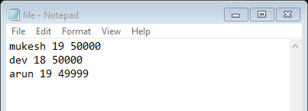
Read Data for Files
fscanf() - Example
#include <stdio.h>
#include <string.h>
int main(){
char name[30];
int age, salary, i=1;
FILE *fp;
fp = fopen("file.txt", "r");
while(i<4){
fscanf(fp, "%s %d %d", name, &age, &salary);
printf("Name: %s\tAge: %d\tSalary: %d\n",name, age, salary);
i++;
}
fclose(fp);
}
Syntax
int fscanf(FILE *stream, const char *format, ...);
output
Name: mukesh Age: 19 Salary: 50000
Name: dev Age: 18 Salary: 50000
Name: arun Age: 19 Salary: 49999

Slide 17
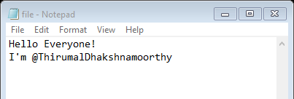
Read Data for Files
fgets() - Example
#include <stdio.h>
#include <string.h>
int main(){
char text[150];
FILE *fp;
fp = fopen("file.txt", "r");
while(!feof(fp)){
fgets(text, 150, fp);
printf("%s", text);
}
fclose(fp);
}
Syntax
int fgets(char *str, int size, FILE *stream);
output
Hello Everyone!
I’m @ThirumalDhakshnamoorthy

Slide 18
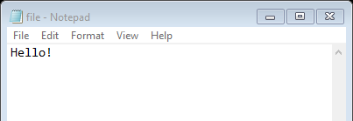
Read Data for Files
fgetc() - Example
#include <stdio.h>
#include <string.h>
int main(){
char ch;
FILE *fp;
fp = fopen("file.txt", "r");
while(!feof(fp)){
ch = fgetc(fp);
printf("%c", ch);
}
fclose(fp);
}
Syntax
int fgetc(FILE *stream);
output
Hello!

Slide 19
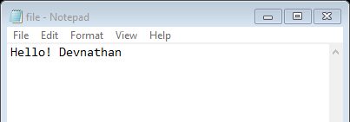
Read Data for Files
fread() - Example
#include <stdio.h>
#include <stdlib.h>
#include <string.h>
int main(){
char text[100];
size_t count;
FILE *fp;
fp = fopen("file.txt", "r");
while(!feof(fp)){
count = fread(text, 1, 20, fp);
printf("%d : %s\n", count, text);
}
fclose(fp);
}
syntax
int fread(void *str, size_t size, size_t num, FILE *stream);
output
Hello! Devnathan

Slide 20

Error Handling
In C programming, error handling is essential to handle unexpected situations or failures that may occur during program execution.
ferror()
clearerr()
perror()
strerr()
feof()

Slide 21
Error Handling
perror()
show the error description
#include <stdio.h>
int main()
{
FILE* file = fopen("needed_file.txt", "r");
if (file == NULL) {
perror("Error");
return 1; }
fclose(file);
return 0;
}
syntax
void perror(char *msg);
Output
Error: No such file or directory

Slide 22
Error Handling
ferror()
check whether an error occurred during a file operation.
#include <stdio.h>
int main(){
FILE *fp;
fp = fopen("test.txt","w");
char ch = fgetc(fp);
if(ferror(fp)){
printf("File is opened in writing mode! You cannot read data from it!");
}
fclose(fp);
return(0);
}
syntax
int ferror(char *msg);
Output
File is opened in writing mode! You cannot read data from it!

Slide 23
Error Handling
clearerr()
Used to clear the end-of-file and error indicators for the stream.
#include <stdio.h>
#include <errno.h>
void main(){
FILE *fp;
char text[100];
fp = fopen("new_file.txt", "r");
if(fp == NULL){
clearerr(fp);
}
printf("Enter some Text: ");
gets(text);
fprintf(fp, "%s", text);
fclose(fp);
}
syntax
void clearerr(FILE *fp);
Output
File is opened in writing mode! You cannot read data from it!

Slide 24

Command line argument
The arguments passed from command line are called command line arguments. These arguments are handled by main() function.
syntax
int main(int argc, char *argv[])
argc - counts the number of arguments. It counts the file name as the first argument.
argv[] - contains the total number of arguments. The first argument is the file name always.

Slide 25
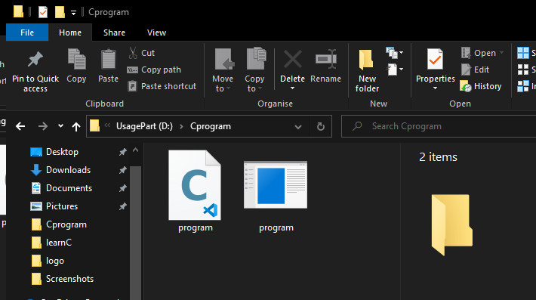
Command line argument
Write program and once run.
#include <stdio.h>
int main(int argc, char *argv[]){
// printf("Hello");
printf("\n%d", argc);
for (int i = 0; i<argc; i++){
printf("\n%s", argv[i]);
}
return 0;
}

Slide 26
Command line argument
Run ‘program.exe’ via terminal or command prompt
#include <stdio.h>
int main(int argc, char *argv[]){
// printf("Hello");
printf("\n%d", argc);
for (int i = 0; i<argc; i++){
printf("\n%s", argv[i]);
}
return 0;
}

Slide 27
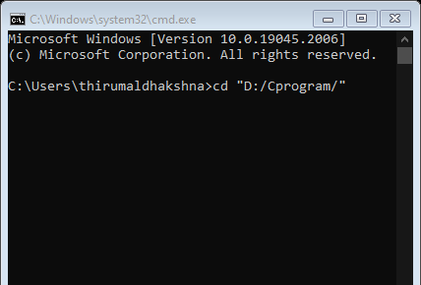
Command line argument
Run ‘program.exe’ via terminal or command prompt
#include <stdio.h>
int main(int argc, char *argv[]){
// printf("Hello");
printf("\n%d", argc);
for (int i = 0; i<argc; i++){
printf("\n%s", argv[i]);
}
return 0;
}
Notes:
26

Slide 28
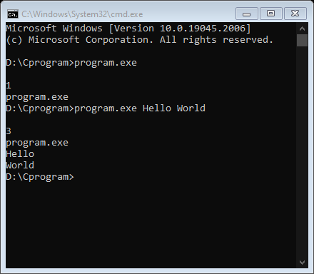
Command line argument
Run ‘program.exe’ via terminal or command prompt
#include <stdio.h>
int main(int argc, char *argv[]){
// printf("Hello");
printf("\n%d", argc);
for (int i = 0; i<argc; i++){
printf("\n%s", argv[i]);
}
return 0;
}
Notes:
26

Slide 29
Command line argument
Run ‘program.exe’ via terminal or command prompt
#include <stdio.h>
int main(int argc, char *argv[]){
// printf("Hello");
printf("\n%d", argc);
for (int i = 0; i<argc; i++){
printf("\n%s", argv[i]);
}
return 0;
}
Notes:
26

Slide 30
Reference:
Reema Thareja
Assistant Professor
Dept of Computer Science
Shyama Prasad Mukherji College for Woman
University of Delhi
Geeks for Geeks
Online Platform of Technical teach site

Slide 31
Special
Start-up Mini Project

